Slide 1
EECT 111
7 Questions
By Charity Fischer
Spring 2018

Slide 2
7 Questions summary
1.) Multiple resistors combine in series and parallel.
2.) By example calculate RT, IT, PT, and all the nodal voltages, branch currents and power
dissipation of a resistor network.
3.) By example calculate the Thevenin Resistance and Voltage of a resistor network.
4.) Multiple capacitors combine in series and parallel.
5.) Multiple inductors combine in series and parallel.
6.) Using a simple RC circuit determine the
a.) Time Constant (not needed)
b.) Create a graph that shows the RC time constant as a function of time (not needed)
c.) Determine XC at a fixed frequency
d.) Create a graph that shows how XC changes as a function of frequency
e.) Plot the frequency response
7.) Using a simple RL circuit determine the
a.) Time Constant (not needed)
b.) Create a graph that shows the RL time constant as a function of time (not needed)
c.) Determine XL at a fixed frequency
d.) Create a graph that shows how XL changes as a function of frequency
e.) Plot the frequency response

Slide 3

Question 1- How To Add Resistors
When adding resistors it’s important to realize that both parallel and series resistors add differently
There is only one necessary way to add resistors in series and that to find the sum of them.
  $Rt=R1+R2+R3…Rn$

Slide 4
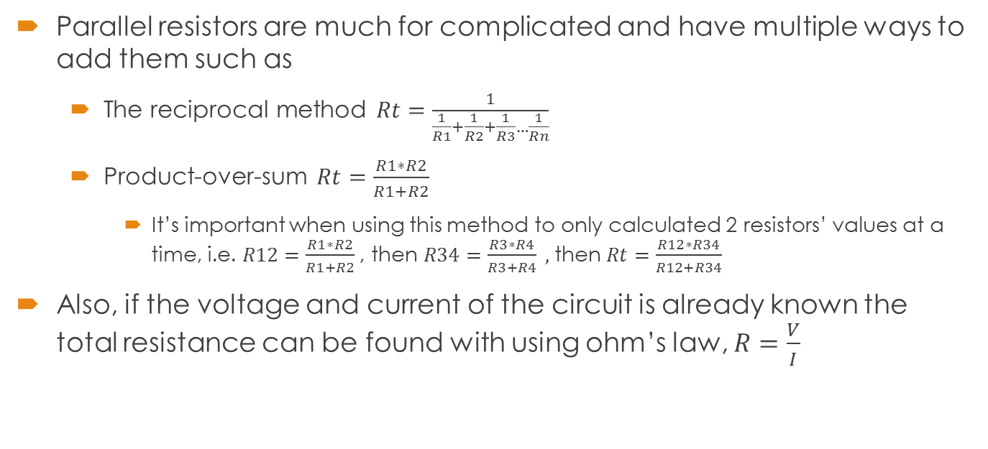
Question 1- How To Add Resistors
Series
R1 | 1.0E+3
R2 | 2.2E+3
R3 | 3.3E+3
R4 | 4.7E+3
Rt | 11.2E+3
Parallel
R1 | 1.0E+3
R2 | 2.2E+3
R3 | 3.3E+3
R4 | 4.7E+3
Rt | 507.5262 | Reciprocal
R12 | 687.5 | Product-over-sum
R34 | 1.9E+3 | Product-over-sum
Rt | 507.5262 | Product-over-sum
Parallel resistors are much for complicated and have multiple ways to add them such as
  The reciprocal method $Rt=\frac{1}{\frac{1}{R1}+\frac{1}{R2}+\frac{1}{R3}…\frac{1}{Rn}}$
  Product-over-sum $Rt=\frac{R1∗R2}{R1+R2}$
    It’s important when using this method to only calculated 2 resistors’ values at a time, i.e. $R12=\frac{R1∗R2}{R1+R2}$, then $R34=\frac{R3∗R4}{R3+R4} ,$ then $Rt=\frac{R12∗R34}{R12+R34}$
Also, if the voltage and current of the circuit is already known the total resistance can be found with using ohm’s law, $R=\frac{V}{I}$

Slide 5
Question 2 – How to calculate RT, IT, PT, nodal voltages, branch currents, and power dissipation of a resistor network
V1 | 9
R1 | 1.0E+3
R2 | 2.2E+3
R3 | 3.3E+3
R4 | 4.7E+3
R23 | 1.3E+3
Rt | 7.0E+3
It | 1.3E-3
The circuit we will be analyzing is a simple parallel and series with 4 resistors and a 9V DC power source
Rt here is calculated first by using product-over-sum to find R23. Then R1, R23, R4 are added together to find Rt
It can be calculated with Rt and the applied voltage using Ohm’s law

Slide 6

Question 2 – How to calculate RT, IT, PT, nodal voltages, branch currents, and power dissipation of a resistor network
V1 = | 9
R1 = | 1.0E+3
R2 = | 2.2E+3
R3 = | 3.3E+3
R4 = | 4.7E+3
R23 = | 1.32E+3
Rt = | 7.02E+3
It = | 1.3E-3 | I=V/Rt
Pt = | 11.538E-3 | P=I*V
Pt = | 11.538E-3 | P=I^2*R
Pt= | 11.538E-3 | P=V^2/R
Pt can be calculated three different ways using current, voltage, and resistance
  $P=I∗V$, $P=I^{2}∗R$, and $P=\frac{V^{2}}{R}$

Slide 7
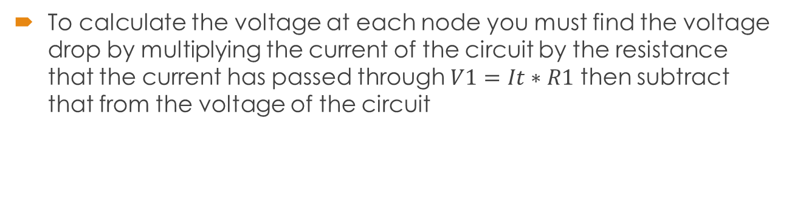
Question 2 – How to calculate RT, IT, PT, nodal voltages, branch currents, and power dissipation of a resistor network
V1 = | 9
R1 = | 1.0E+3
R2 = | 2.2E+3
R3 = | 3.3E+3
R4 = | 4.7E+3
R23 = | 1.32E+3
Rt = | 7.02E+3
It = | 1.3E-3 | I=V/Rt
Pt = | 11.538E-3 | P=I*V
Pt = | 11.538E-3 | P=I^2*R
Pt = | 11.538E-3 | P=V^2/R
VA = | 1.2821 | V=I*R
V-VA = | 7.7179
VB = | 2.9744 | V=I*R
V-VB = | 6.0256
To calculate the voltage at each node you must find the voltage drop by multiplying the current of the circuit by the resistance that the current has passed through $V1=It∗R1$ then subtract that from the voltage of the circuit

Slide 8
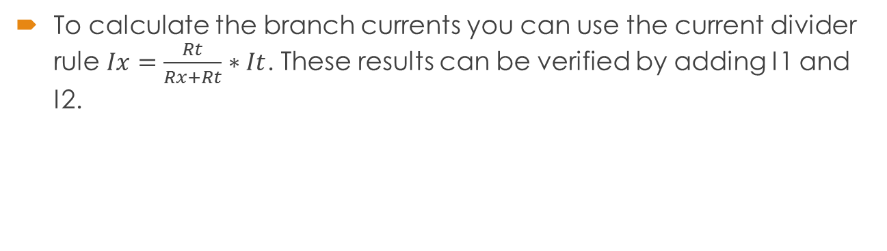
Question 2 – How to calculate RT, IT, PT, nodal voltages, branch currents, and power dissipation of a resistor network
V1 = | 9
R1 = | 1.0E+3
R2 = | 2.2E+3
R3 = | 3.3E+3
R4 = | 4.7E+3
R23 = | 1.32E+3
Rt = | 7.02E+3
It = | 1.28E-3 | I=V/Rt
Pt = | 11.538E-3 | P=I*V
Pt = | 11.538E-3 | P=I^2*R
Pt = | 11.538E-3 | P=V^2/R
VA = | 1.2821 | V=I*R
V-VA = | 7.7179
VB = | 2.9744 | V=I*R
V-VB = | 6.0256
I1 = | 1.28E-3 | I=V/Rt
I2 = | 769.2E-6 | I2=(It*R3)/(R2+R3)
I3 = | 512.8E-6 | I3=(It*R2)/(R3+R2)
I4 = | 1.28E-3 | I=V/Rt
To calculate the branch currents you can use the current divider rule $Ix=\frac{Rt}{Rx+Rt}∗It$. These results can be verified by adding I1 and I2.

Slide 9
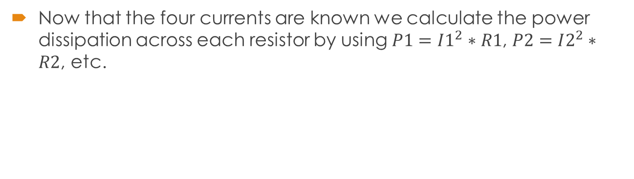
Question 2 – How to calculate RT, IT, PT, nodal voltages, branch currents, and power dissipation of a resistor network
V1 = | 9
R1 = | 1.0E+3
R2 = | 2.2E+3
R3 = | 3.3E+3
R4 = | 4.7E+3
R23 = | 1.32E+3
Rt = | 7.02E+3
It = | 1.28E-3 | I=V/Rt
Pt = | 11.538E-3 | P=I*V
Pt = | 11.538E-3 | P=I^2*R
Pt = | 11.538E-3 | P=V^2/R
VA = | 1.2821 | V=I*R
V-VA = | 7.7179
VB = | 2.9744 | V=I*R
V-VB = | 6.0256
I1 = | 1.28E-3 | I=V/Rt
I2 = | 769.2E-6 | I2=(It*R3)/(R2+R3)
I3 = | 512.8E-6 | I3=(It*R2)/(R3+R2)
I4 = | 1.28E-3 | I=V/Rt
P1 = | 1.64E-3 | P=I1^2*R1
P2 = | 1.30E-3 | P=I2^2*R2
P3 = | 867.85E-6 | P=I3^2*R3
P4 = | 7.73E-3 | P=I4^2*R4
Now that the four currents are known we calculate the power dissipation across each resistor by using $P1=I1^{2}∗R1$, $P2=I2^{2}∗R2$, etc.

Slide 10
Question 3 – Thevenin Resistance and Voltage of a Resistor Network
Thevenin’s theorem is used to simplify complex resistor networks just as we did to find Rt in question 2.
The network we will be analyzing using Thevenin’s theorem is a parallel and series circuit with 5 resistors at two different values with 50V of applied voltage

Slide 11
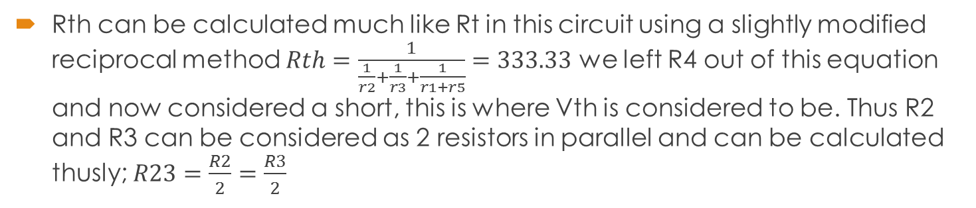
Question 3 – Thevenin Resistance and Voltage of a Resistor Network
Rth can be calculated much like Rt in this circuit using a slightly modified reciprocal method $Rth=\frac{1}{\frac{1}{r2}+\frac{1}{r3}+\frac{1}{r1+r5}}=333.33$ we left R4 out of this equation and now considered a short, this is where Vth is considered to be. Thus R2 and R3 can be considered as 2 resistors in parallel and can be calculated thusly; $R23=\frac{R2}{2}=\frac{R3}{2}$
V1 = | 50
R1 = | 500
R2 = | 1000
R3 = | 1000
RL = | 500
R5 = | 500
R_{TH} = | 333.33
R23 = | 500.00

Slide 12
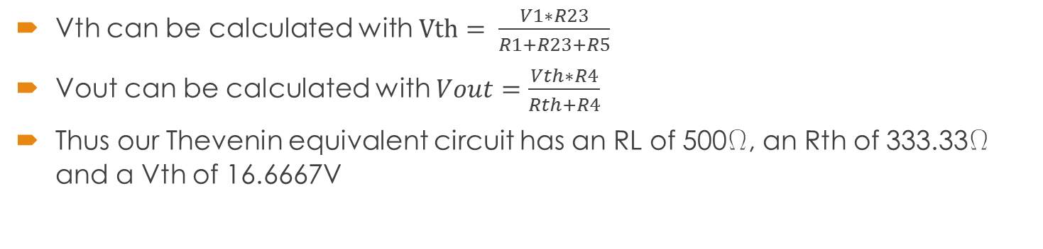
Question 3 – Thevenin Resistance and Voltage of a Resistor Network
Vth can be calculated with $Vth= \frac{V1∗R23}{R1+R23+R5}$
Vout can be calculated with $Vout=\frac{Vth∗R4}{Rth+R4}$
Thus our Thevenin equivalent circuit has an RL of 500W, an Rth of 333.33W and a Vth of 16.6667V
V1 = | 50
R1 = | 500
R2 = | 1000
R3 = | 1000
RL = | 500
R5 = | 500
R_{TH} = | 333.33
R23 = | 500.00
V_{TH} = | 16.66667
Vout = | 10

Slide 13
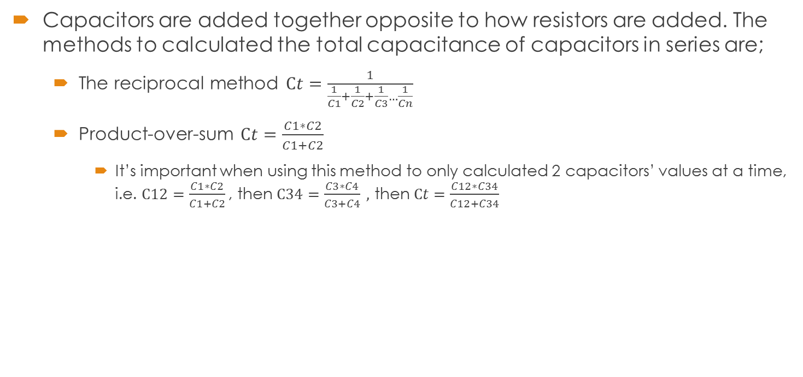
Question 4 – How to combine Capacitors
Capacitors are added together opposite to how resistors are added. The methods to calculated the total capacitance of capacitors in series are;
  The reciprocal method $Ct=\frac{1}{\frac{1}{C1}+\frac{1}{C2}+\frac{1}{C3}…\frac{1}{Cn}}$
  Product-over-sum $Ct=\frac{C1∗C2}{C1+C2}$
    It’s important when using this method to only calculated 2 capacitors’ values at a time, i.e. $C12=\frac{C1∗C2}{C1+C2}$, then $C34=\frac{C3∗C4}{C3+C4} ,$ then $Ct=\frac{C12∗C34}{C12+C34}$
Series
C1 | 10.0E-6
C2 | 22.0E-6
C3 | 47.0E-6
Ct | 6.0E-6

Slide 14

Question 4 – How to combine Capacitors
There is only one necessary way to add resistors in series and that to find the sum of them.
  $Ct=C1+C2+C3…Cn$
You can also calculate the total capacitance if the total charge and voltage is known with $C=\frac{Q}{V}$
Parallel
C1 | 10.0E-6
C2 | 22.0E-6
C3 | 47.0E-6
Ct | 79.0E-6

Slide 15
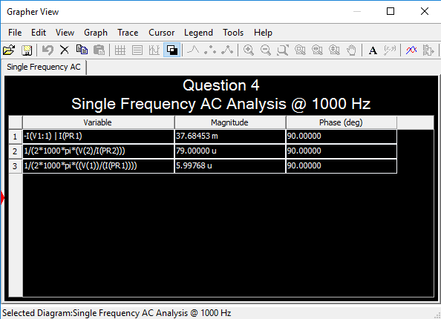
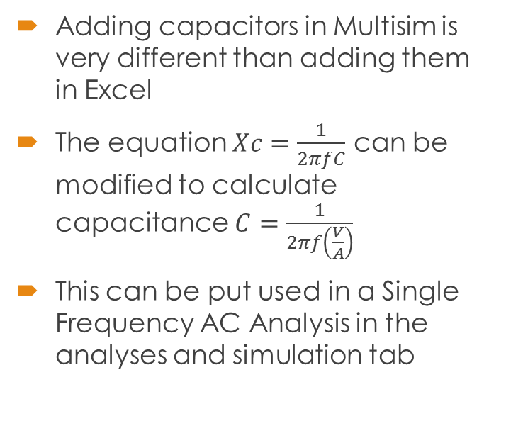
Question 4 – How to combine Capacitors
Adding capacitors in Multisim is very different than adding them in Excel
The equation $Xc=\frac{1}{2πfC}$ can be modified to calculate capacitance $C=\frac{1}{2πf\left(\frac{V}{A}\right)}$
This can be put used in a Single Frequency AC Analysis in the analyses and simulation tab

Slide 16

Question 5 – How to combine Inductors
Adding inductors is much like adding resistors because you use the same equations with both parallel and series circuits
There is only one necessary way to add resistors in series and that to find the sum of them.
  $Lt=L1+L2+L3…Ln$
Series
L1 | 1.0E-3
L2 | 2.2E-3
L3 | 4.7E-3
Lt | 7.9E-3

Slide 17
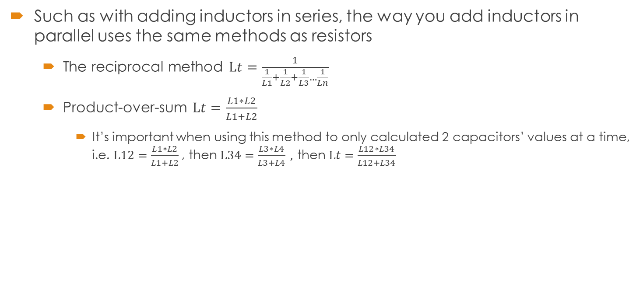
Question 5 – How to combine Inductors
Such as with adding inductors in series, the way you add inductors in parallel uses the same methods as resistors
  The reciprocal method $Lt=\frac{1}{\frac{1}{L1}+\frac{1}{L2}+\frac{1}{L3}…\frac{1}{Ln}}$
  Product-over-sum $Lt=\frac{L1∗L2}{L1+L2}$
    It’s important when using this method to only calculated 2 capacitors’ values at a time, i.e. $L12=\frac{L1∗L2}{L1+L2}$, then $L34=\frac{L3∗L4}{L3+L4} ,$ then $Lt=\frac{L12∗L34}{L12+L34}$
Parallel
L1 | 1.0E-3
L2 | 2.2E-3
L3 | 4.7E-3
Lt | 599.8E-6

Slide 18
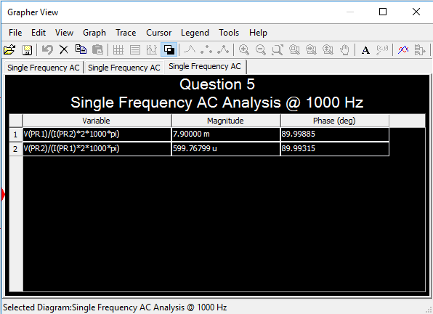
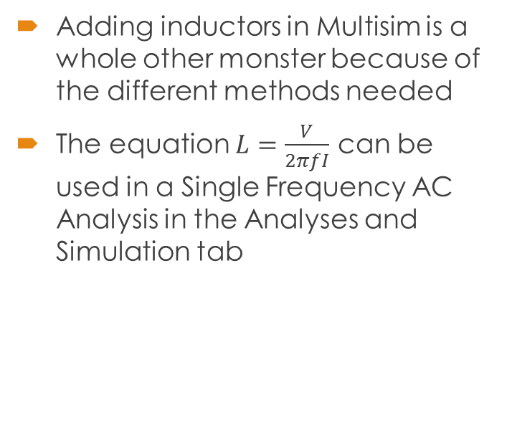
Question 5 – How to combine Inductors
Adding inductors in Multisim is a whole other monster because of the different methods needed
The equation $L=\frac{V}{2πfI}$ can be used in a Single Frequency AC Analysis in the Analyses and Simulation tab

Slide 19

Question 6 – RC Circuit
The Xc of an RC circuit is calculated with the equation $Xc=\frac{1}{2πfC}$
If the fixed frequency we want to read is at 1000 and the capacitance is 2.2uF the equation is $Xc=\frac{1}{2∗π∗1000∗.0000022}=72.3$
Pi | p
f | 1000
C | 2.2E-6
Xc | 72.34316

Slide 20
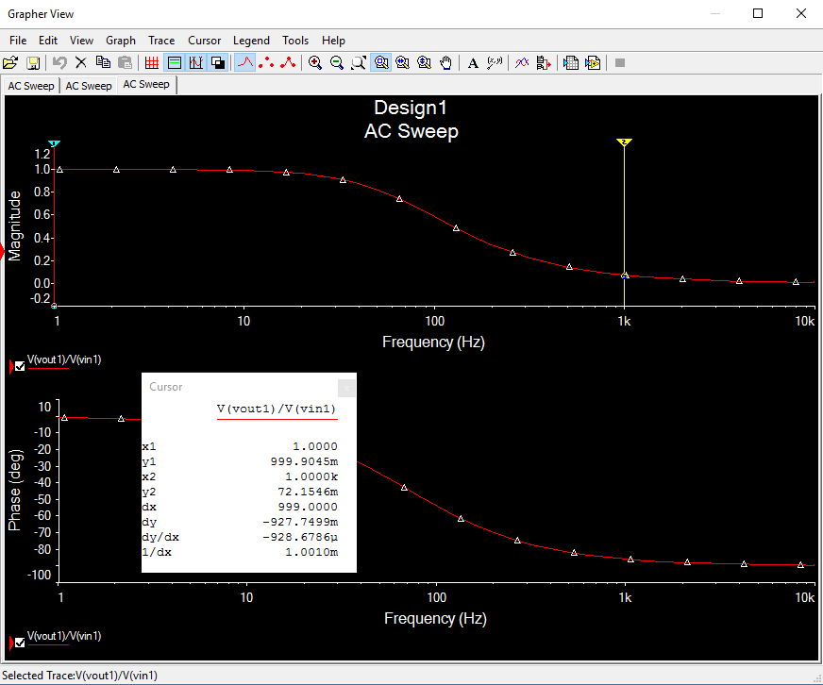
Question 6 – RC Circuit

Slide 21

Question 7 – RL Circuit
The Xl of an RL circuit is calculated with the equation $Xl=2∗π∗f∗L$
If the fixed frequency is we want to read Xl at is 1000 and the L of the circuit is 115.1uH then the equation would come out to $Xl=2∗π∗1000∗0.0001151=723.4uH$
Pi | p
f | 1000
L | 115.1E-6
Xl | 723.4E-3

Slide 22
Question 7 – RL Circuit

